Slide 1
Uncovering the underlying visual representations of visual memory overtime

Slide 2
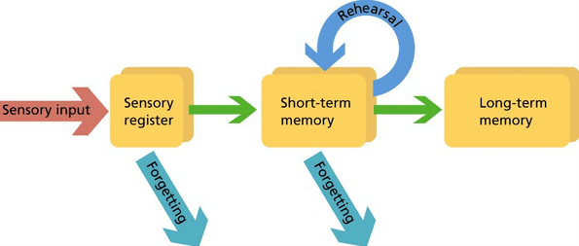
Memory consolidation process
Memory representation changes from short term memory (Hippocampus based) to long term memory (Neocortex based).
Short term memory is detailed (low level features) while long term memory is mostly gist based (high level features).
Detailed memory
Memory gist
(Winocur & Moscovitch, 2021)

Slide 3
Multiple aspects of memory gist
Color is associated with scene gist (Castelhano & Henderson, 2008).
Texture provides a strong cue for scene identification during early scene processing (Renninger & Malik, 2004).
The spatial layout properties provide a statistical summary of an image and able us to identify the gist of an image (Oliva & Torralba, 2006).

Slide 4
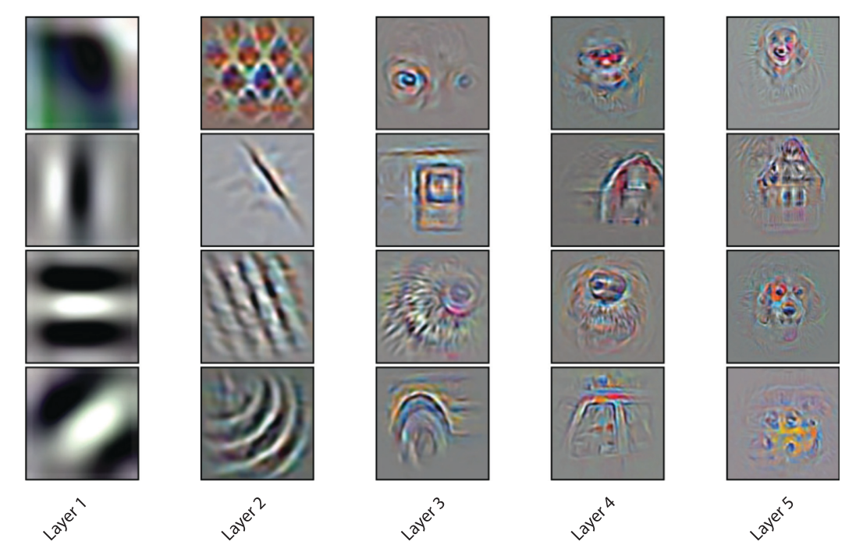
CNN visual processing hierarchy
Low level features
Texture\patterns
Concepts
(Zeiler & Fergus, 2014) (Kriegeskorte, 2015)
Notes:
אחת הדרכים להבין לעומק יותר מהו תהילך העיבוד שמתרחש בשכבות הרשת ניתן למצוא את התמונות אשר יעוררו בצורה מיריבית את אותו הנוירון ובכך ללמוד למה הוא רגיש.
ניתן לראות כי היחידות ברשת לומדות סלקטיביות לפיצרים שגדלים ברמת מורכבותן בצורה היררכית ברשת.
שכבות נמוכות רגישות לניגודיות או קווי מתאר ואוריינטציות, שכבות גבוהות רגישות כבר לאובייקטים שלמים.
צריך לשים לב שעבור התמונה הזו נבחרו יחידות ספציפיות שניתן לפענח את הסלקטיביות שלהן ובפועל קיימים עוד יחידות רבות שקשה להבין בדיוק למה הן רגישות.
יכול להיות שדווקא קומבינציה של יחידות או שכבות מבטאות יותר את הסלקטיביות ולאוו דווקא יחידות בודדות

Slide 5
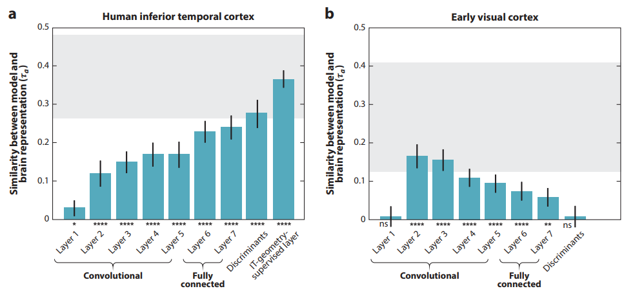
CNN and human visual hierarchal processing
Representational similarity in the visual stream corresponds with CNN hierarchy.
(Kriegeskorte, 2015) (Yamins & DiCarlo, 2016)
Notes:
הראו לנבדקים ב FMRI תמונות של אובייקטים וביצעו סריקות של האיזורים הויזלאוליים הרלונטים.
הוציאו מהמודל של האקטיבציה עבור אותן התמונות.
חישבו מדד של דימיון (קורלציה) בין ה FEATURE VECTOR לבין ה ROI ומיצעו על פני נבדקים וגירויים.

Slide 6
Which representations, across the visual processing hierarchy, are accessible during memory retrieval (and how does it change trough time?)

Slide 7
Advantages of the method
Avoids specific definitions of features to create the dataset. Only relies on CNN hierarchy.
Allows to examine the relative contribution of each similarity level to each memory representation duration. (what representation is dominant of what stage of memory?)
Will allow to examine the dynamics of memory representations across time
Will allow to compare memory representation dynamics between stimulus types (i.e., natural scenes vs abstract images)

Slide 8
Pilot 1

Slide 9
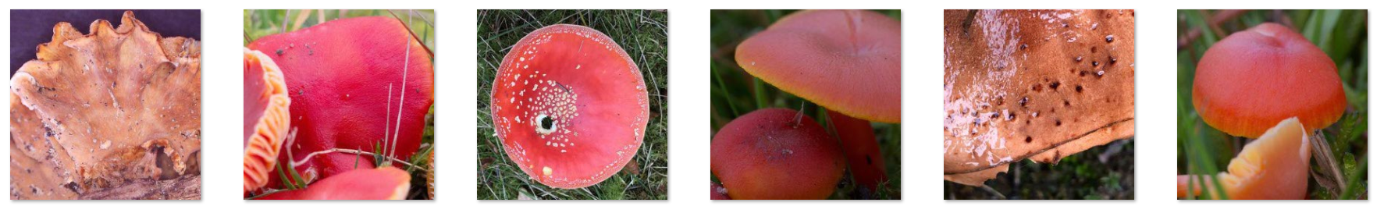
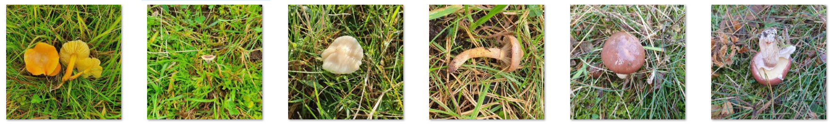
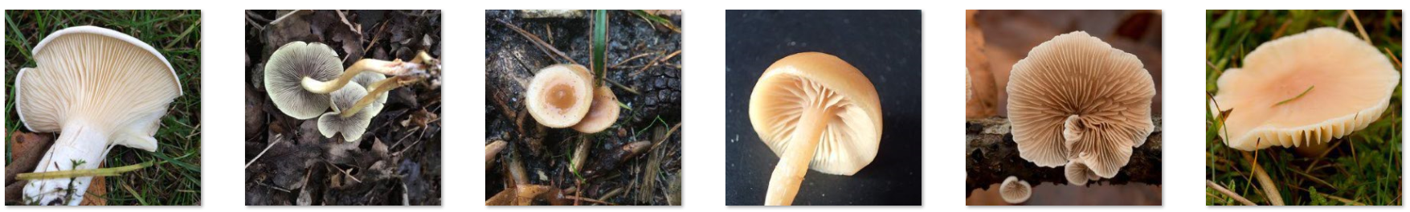
Automatically defining memory task sets based on CNN similarity
CNN (vgg16)
Top n similar images (level1)
Image 1
Image 2
Image
n
Level 1 representation
Level 1 similarity
S1_2
S1_n
S2_n
Level 2
representation
Level 2 similarity
(cosine)
S1_2
S1_n
S2_n
Level n
representation
Top n similar images (level n)
Level 2 similarity
(cosine)
S1_2
S1_n
S2_n

Slide 10
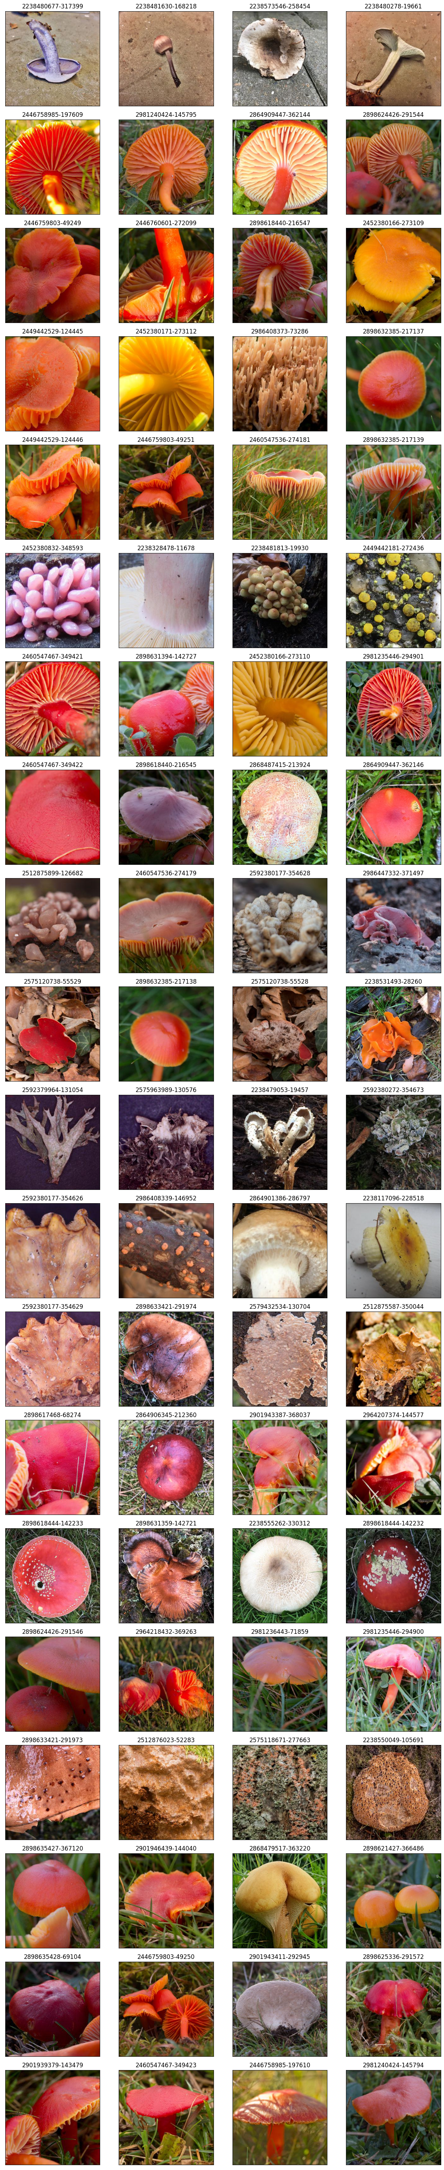
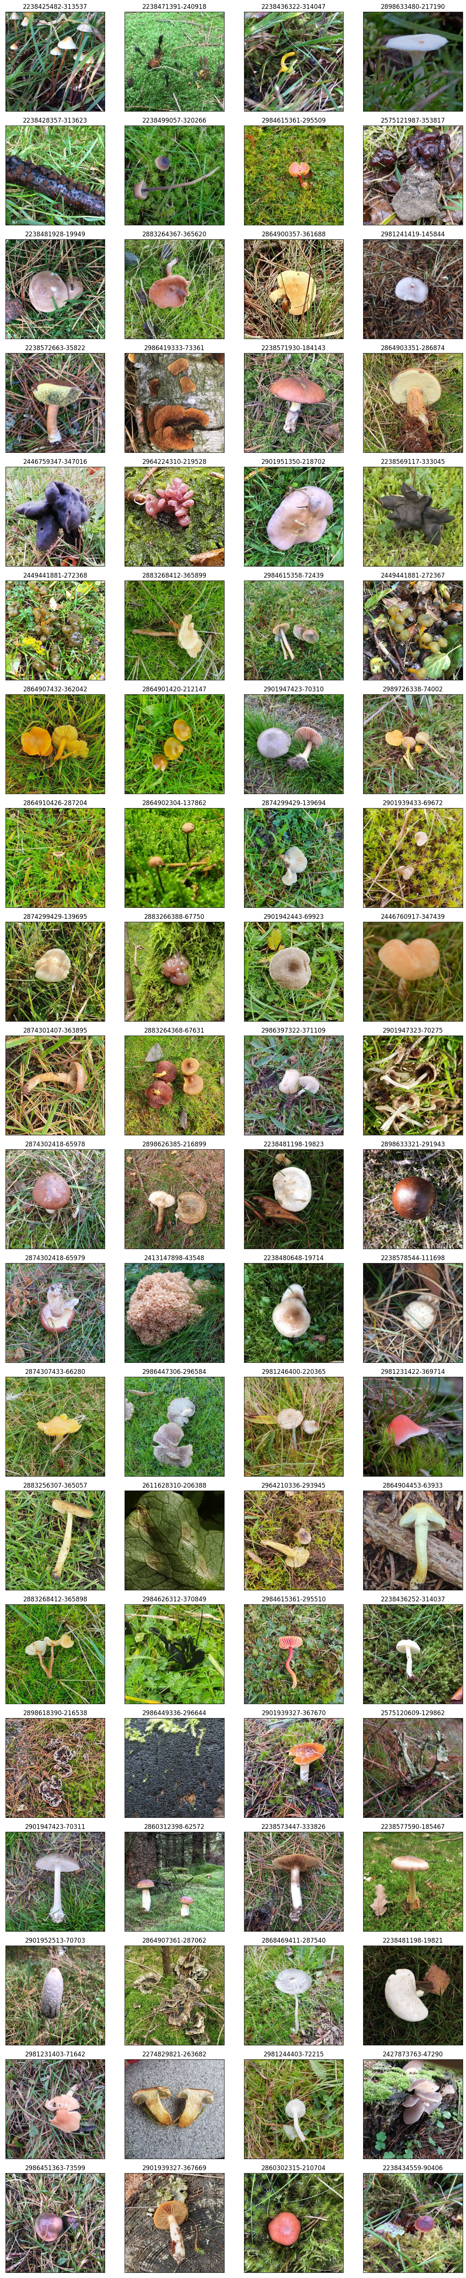
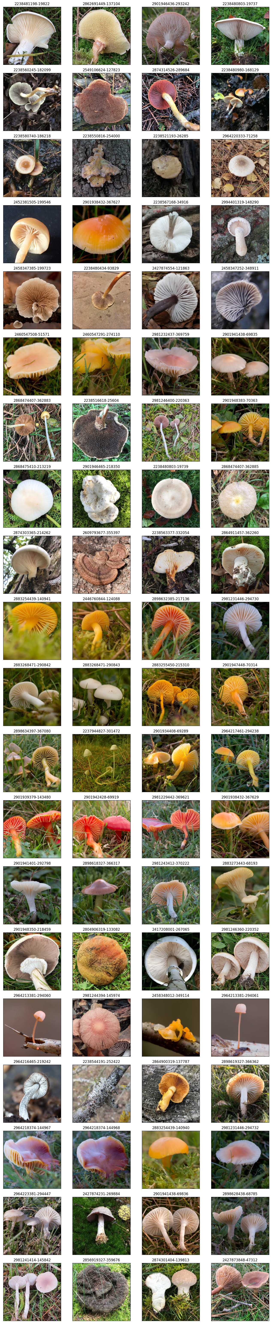
Creating the experiment
Selecting 60 target images (20 for each layer)
For each target image – 3 distractors

Slide 11
Creating the experiment
Participants will be requested to memorize the 60 target images
In different groups (retention interval length) participant will perform a 2afc memory task (selecting the old image)
This will be done using M-turk with Pavlovia

Slide 12
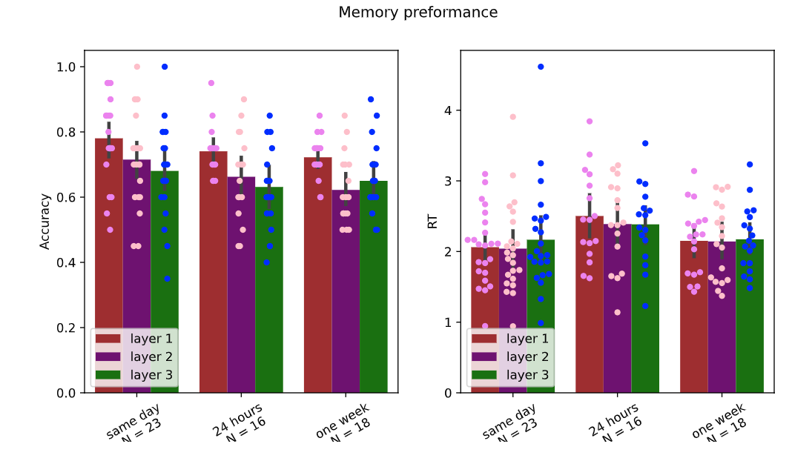
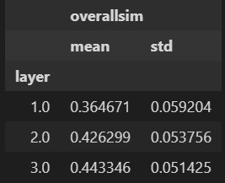
Results pilot 1

Slide 13
Pilot 2

Slide 14
Creating the experiment

Slide 15
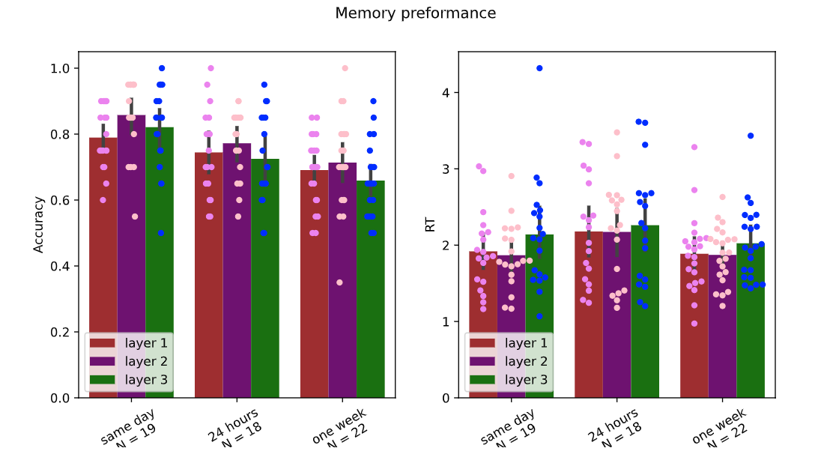
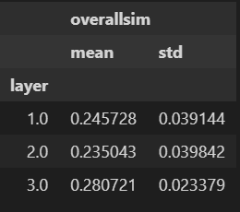
Results pilot 2

Slide 16
Pilot 3

Slide 17
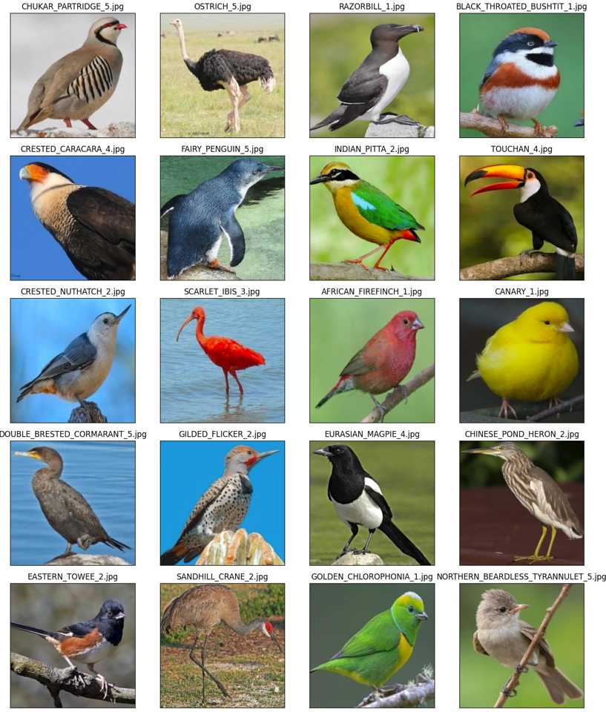
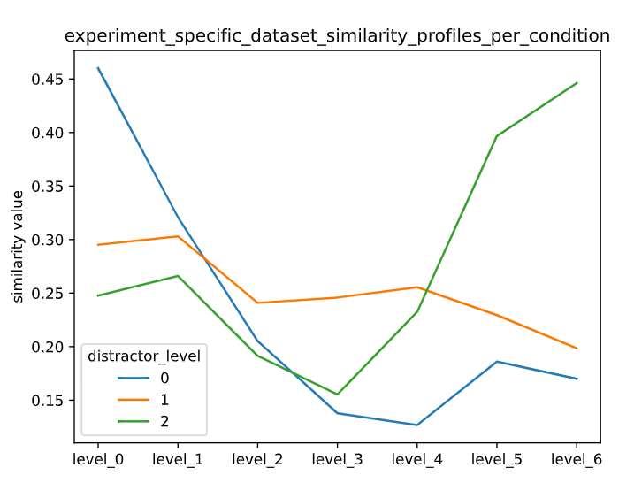
Birds dataset

Slide 18
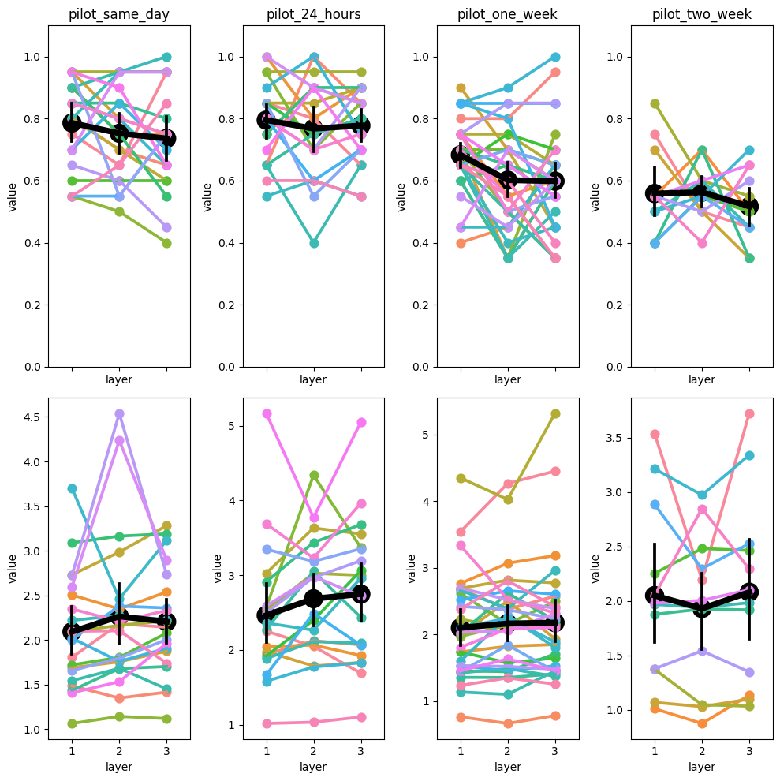
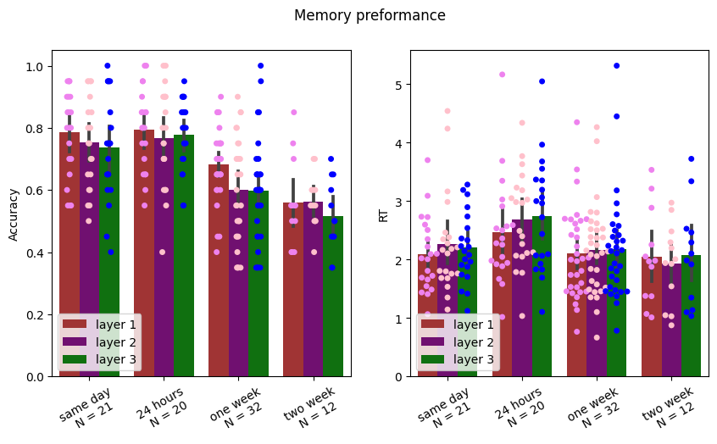
Results pilot 3

Slide 19
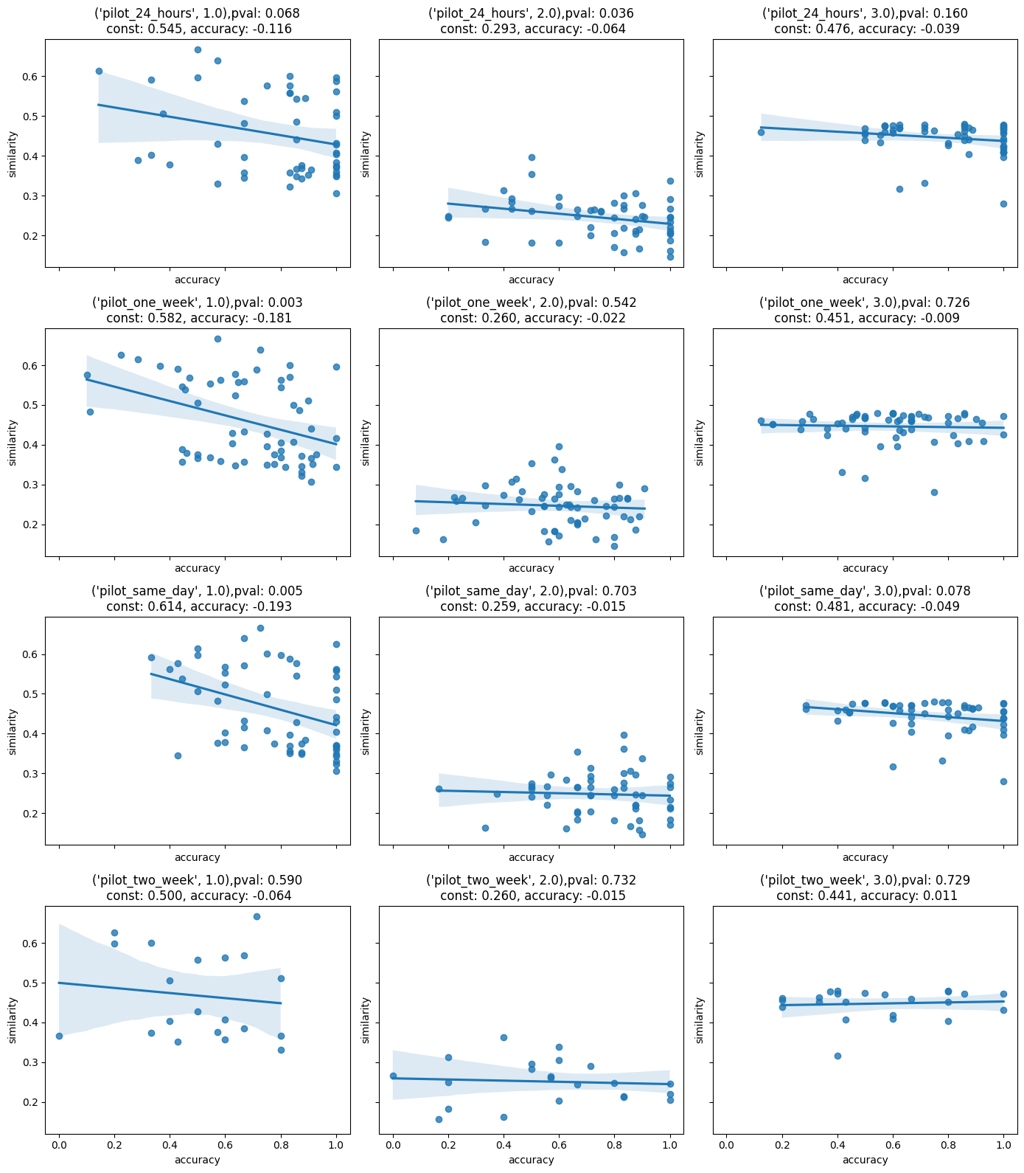
Results pilot 3

Slide 20
Pilot 4

Slide 21
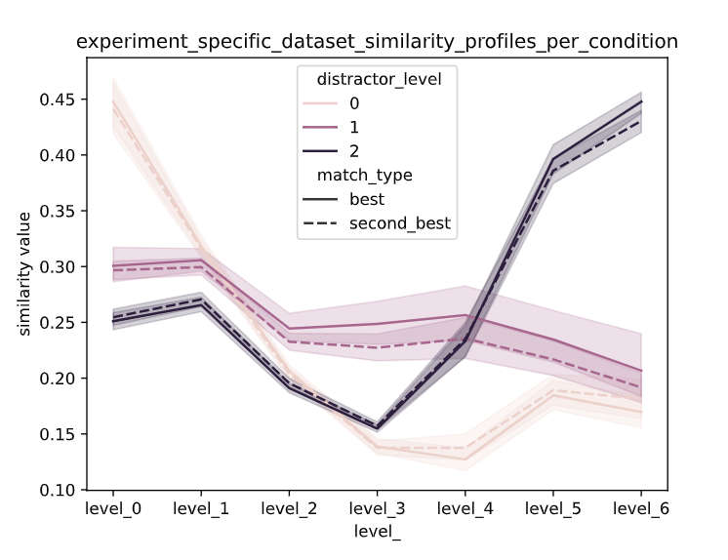
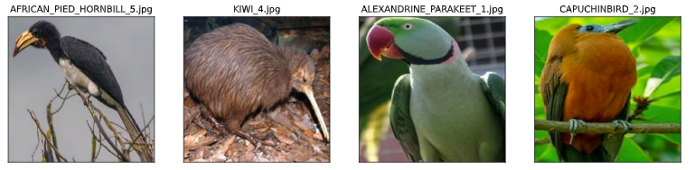
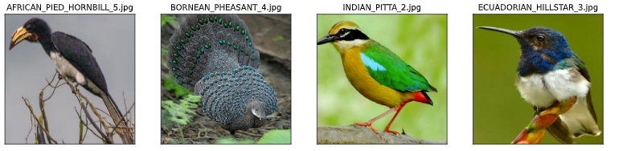
Perceptual Pilot
Best:
Second Best:

Slide 22
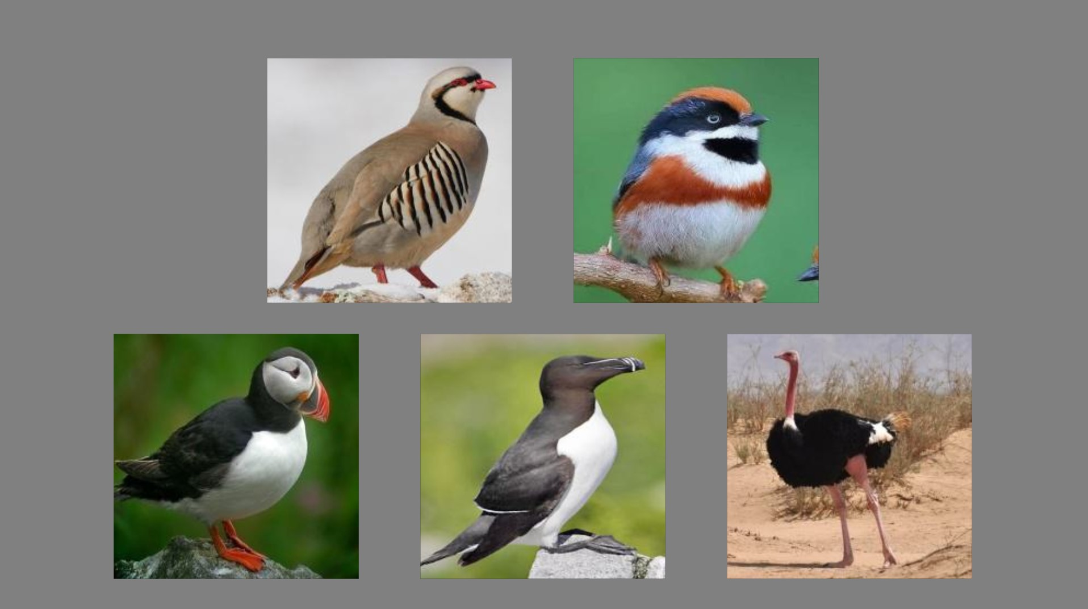
Perceptual Pilot

Slide 23
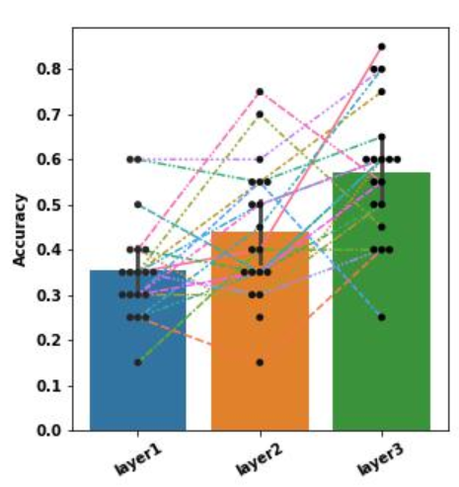
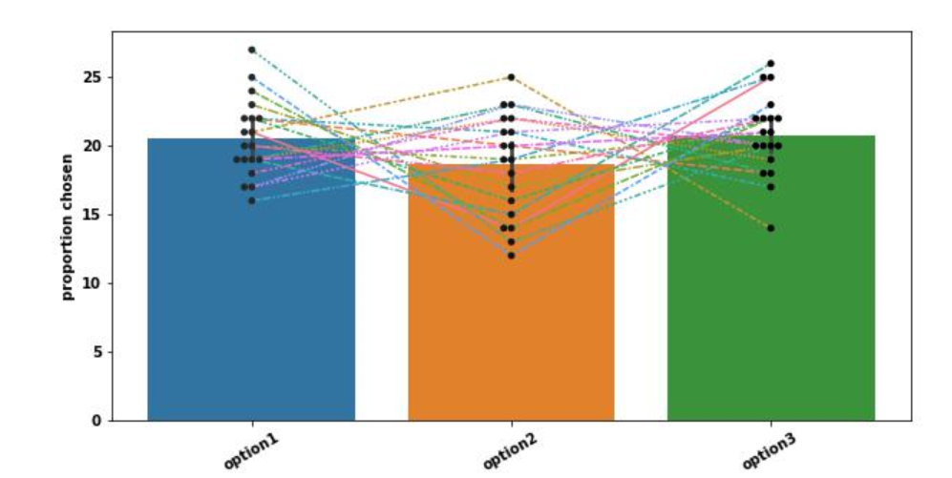
Perceptual Pilot Results

Slide 24
Future Directions
Re-run the bird's dataset pilot with more subjects
Create a multi-category dataset

Slide 25
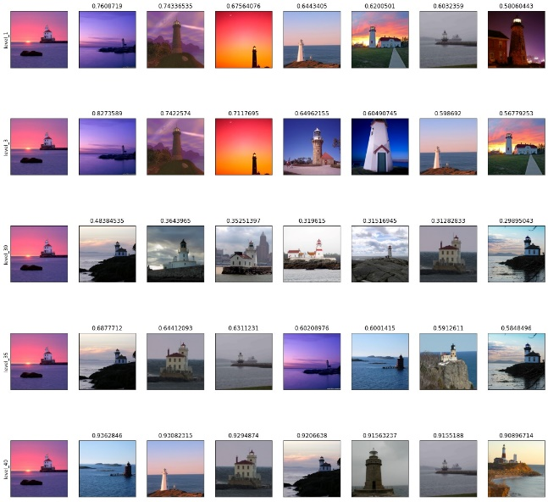
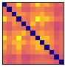
Memory task and creating memory related representation matrix
Participants will be requested to memorize a set of images
In different groups (retention interval length) participant will perform a 2afc memory task (selecting the old image)
N responses will be collected for each image pair, at each retention interval.
This will allow us to create a representation dissimilarity matrix (RDM) for each memory interval:
Colors represents the proportion to select the “new” image from the pair

Slide 26
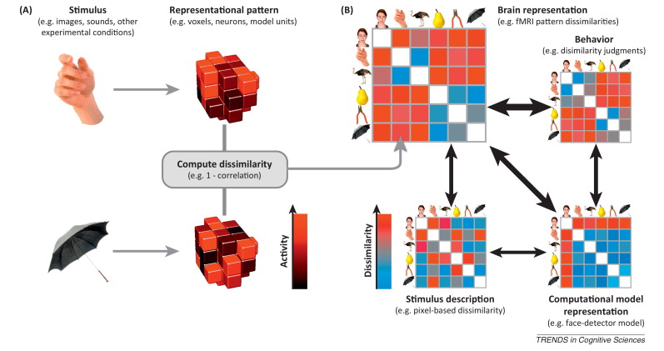

Slide 27
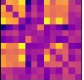
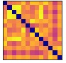

Comparing CNN and memory based RDM
RDM – extracted from CNN activations at different layers:
Layer 1
Layer 2
Layer n
Which CNN based RDM corresponds best to which memory interval based RDM?
RDM – based on different retention interval durations
1 day
1 week
1 month

Slide 28
Advantages of the method and future potential
Avoids specific definitions of features to create the dataset. Only relies on CNN hierarchy.
Allows to examine the relative contribution of each similarity level to each memory representation duration. (what representation is dominant of what stage of memory?)
Will allow to examine the dynamics of memory representations across time
Will allow to compare memory representation dynamics between stimulus types (i.e., natural scenes vs abstract images)
Notes:
הפרשנות האינטואיטיבית המילולית שאנחנו מנסים להעניק עבור גיסט' או פיצ'רים נמוכים כמו צבע או אוריינטציה עשויה לעזור להבנה האינטואיטיבית שלנו. עם זאת, פירושים מילוליים כאלה עשויים להפחית במידת המורכבות האמיתית של ייצוגים אלו.
שימוש ברשת קונבולוציה, אשר מראה דימיון רב לעיבוד הויזלואלי ההיררכי שלנו עשוי להיות הדרך האובייקטיבית ביותר ללמידה על ייצוגי הזיכרון הויזואלי לאורך זמן.

Slide 29
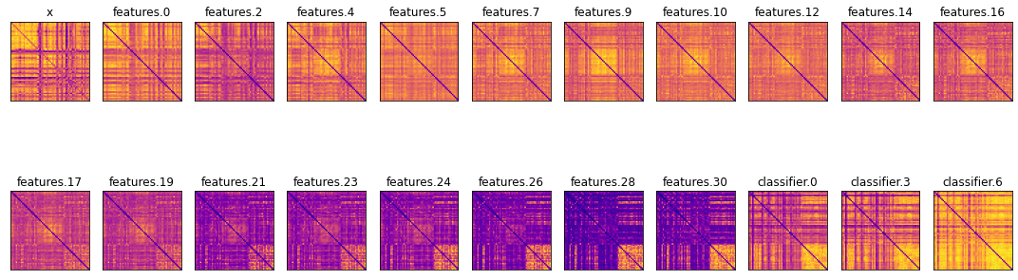
Empirical CNN (VGG16) based RDM on our lighthouses mock data.

Slide 30
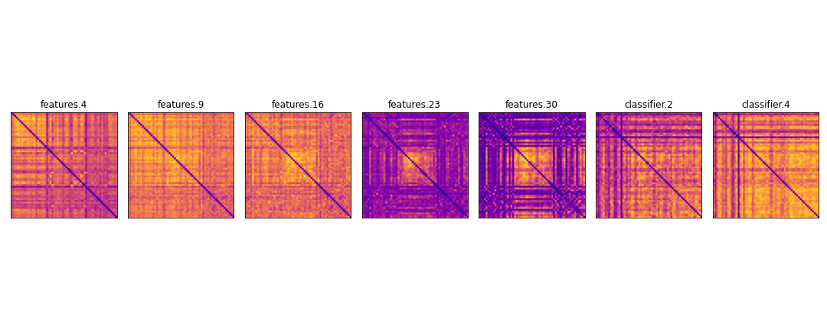
Convolutions and maxpooling layers

Slide 31
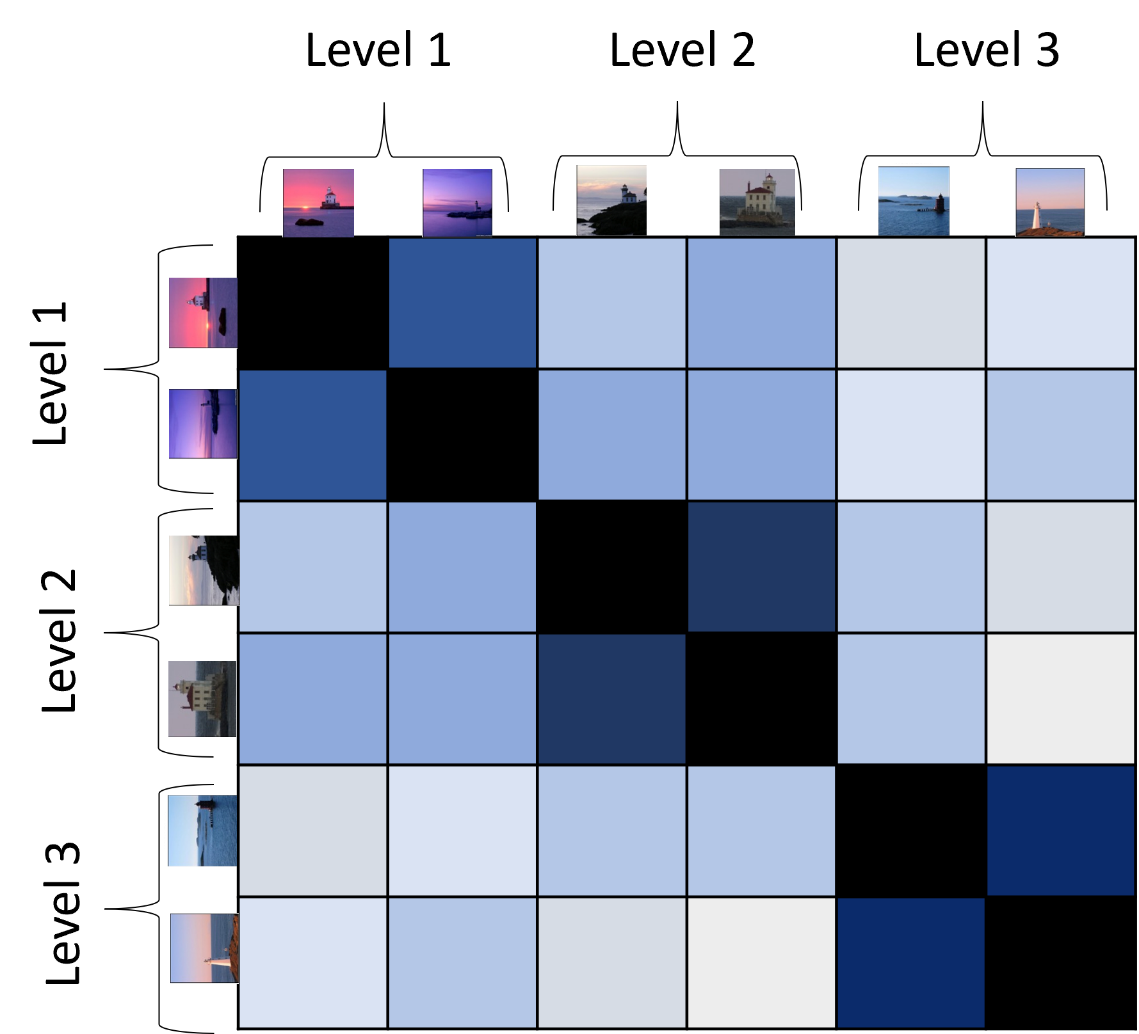
Option 1
- Choose X images that are similar to each other on level L1, L2, L3
- Create all possible pairs between these X images
Creating test :
We create all possible pair combinations: N images will have( N-1)/2 possible pairs
For each subject we choose a random set of pairs
We will have 20 results for each possible pair over all subjects
Recreate this test for 3 intervals:
Hours
week
month

Slide 32
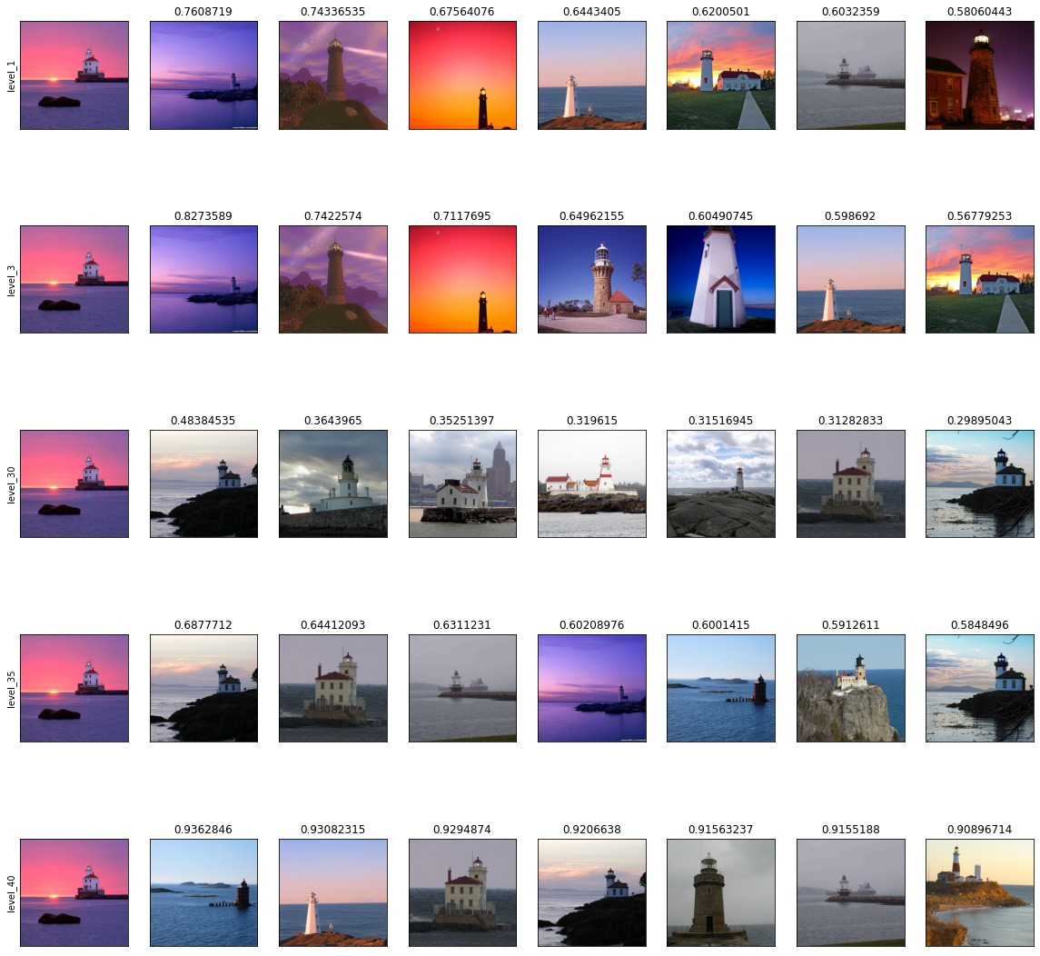
Option 2
Choose X images from datasets
For each image choose three matching images from the same semantic category such that they are the most similar to the reference image according to the representation levels.
Encoding phase :
All subjects see all X images
Testing phase (three retention intervals (between participants))
For each participant randomly (with no replacement) select X/3 images from each representation level
Testing (on X pairs) is 2afc with the seen image and the selected match.
Statistical design:
- Mixed effects ANOVA:
Within – representation level
Between – retention interval.
Target
Level 1
Level 2
Level 3

Slide 33
Pros vs Cons
Option 1 |  | Option 2
Pros | Cons | Pros | Cons
 | One semantic category | Many semantic categories
RDM - Interesting follow up analysis |  |  | Limited follow up analysis
Analysis on different networks
 | Cost inefficient | Cost efficient
Comparison to different types of measures (MRI, ..)
 | Expensive to pilot | Easy to pilot

Slide 34
Open questions and pilots
Questions that defines different “conditions/pilots”:
How many images each subjects should memorize?
Should we also pilot the longest interval? To make sure we don’t get floor effects for all images ?
Should we pilot different datasets? (i.e. fungi's and lighthouses)
Should the instructions show the task? (should the participants understand from the very beginning that all images will be from the same semantic category?)
Design choice questions (which we should talk about, but not pilot different alternatives) :
What are the short-term memory performance for distractors in different layers (make sure we avoid ceiling/floor effects (at least in a same-day design)
Pilot design – non-RDM? (as RDM takes too many participants)
How many participants per cell/group in the pilot ?
What attention checks should we use? (random easy math questions? Should we disqualify during the experiment?)
Do we need a distractor task at the end of the encoding phase?
Duration of images presentation and ITI?
Retrieval task: do we emphasize speed? (so we can use RTs)?

Slide 35
Prerequisites:
Participants were required to have at least a 98% AMT approval rate,500+ completed tasks, and an IP address in the United States
three basic English screening questions and followed by a task instruction question to ensure quality of the data
Time intervals
Stimuli onset: 750 ms , 1 sec ,2
interstimulus interval 800 ms, 1.4 sec , 1
Attention during encoding:
Continuous performance tasks (CPTs), in which participants repeatedly make the same response to most stimuli, but then must make a different response to a rarely presented stimulus. (1)
identified whether the object was living or non-living (2)
Pay:
0.5$ encoding
4.5$ test
https://www.sciencedirect.com/science/article/pii/S0010027722001895?casa_token=VbnwEigzkxcAAAAA:34dHKPXm3r07RX2WXuov29toXRY4v8mDwdvZXuY-qiIY0uHsAvjt2XO2QHSKoKJ1_fHQB1fl
https://link.springer.com/content/pdf/10.3758/s13421-020-01130-5.pdf

Slide 36
https://link.springer.com/article/10.3758/s13428-021-01732-0
Cognitive test on mturk are as good as laboratory
Prescreening process

Slide 37
Level 1
Level 2
Level 3
Level 1
Level 2
Level 3

